Slide 1
18 July
Network latency
1. show average, 25% 50%. etc 2. Random week, list a table of the statistics

Slide 2
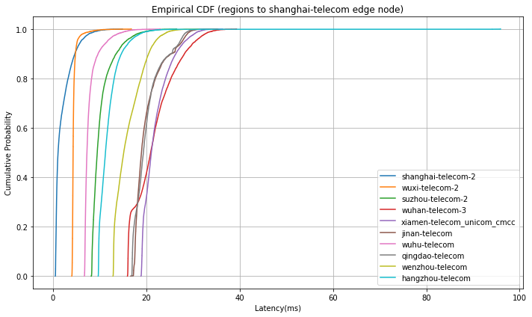
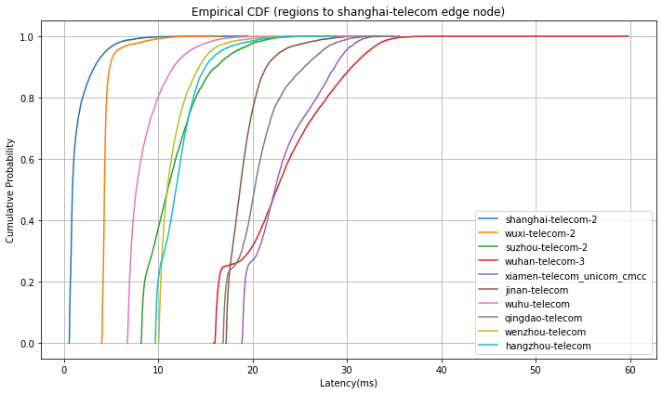
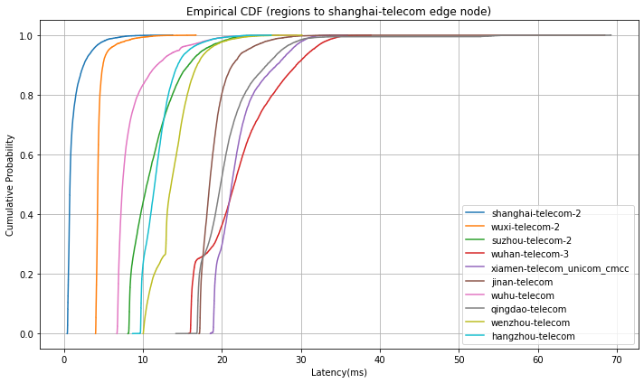
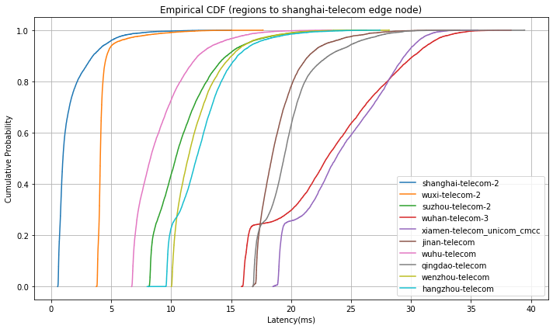
Regions to Shanghai-telecom (1 week)
5.31-6.7
6.14-6.21
6.7-6.14
6.21-6.28

Slide 3
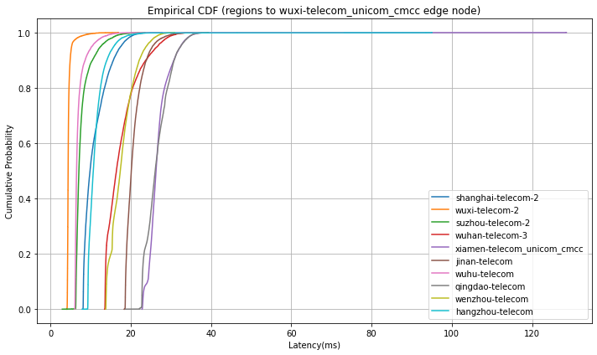
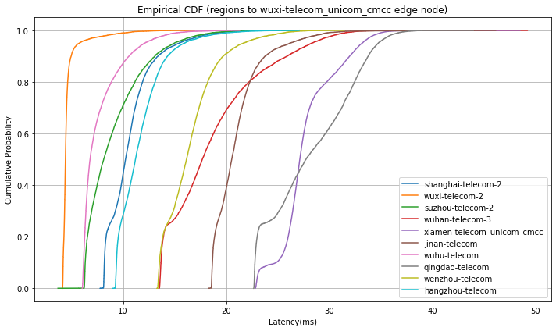
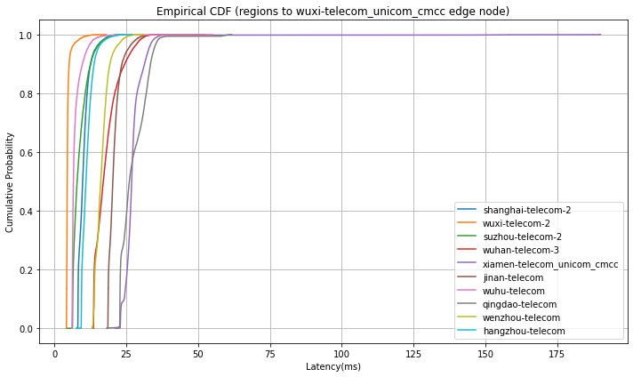
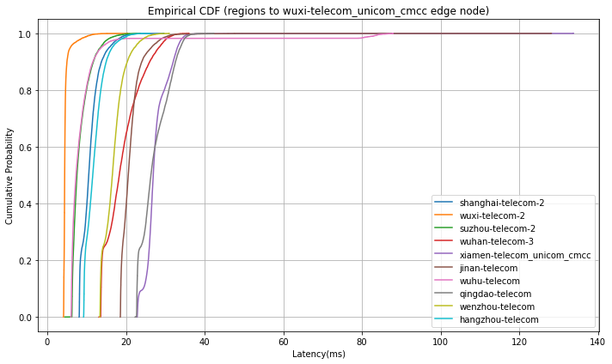
Regions to Wuxi-telecom_unicom_cmcc (1 week)
5.31-6.7
6.14-6.21
6.7-6.14
6.21-6.28

Slide 4
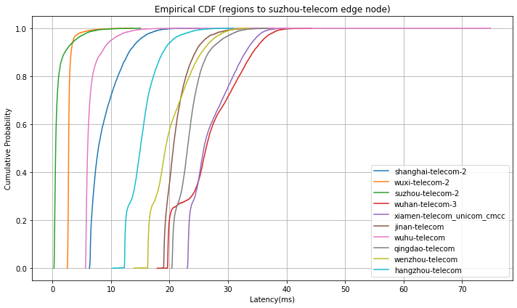
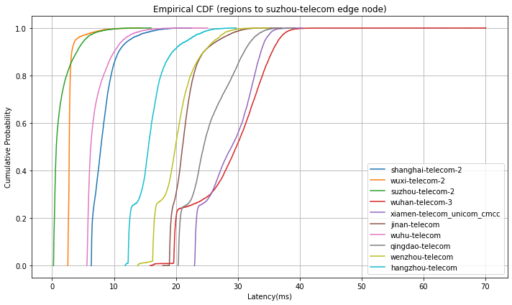
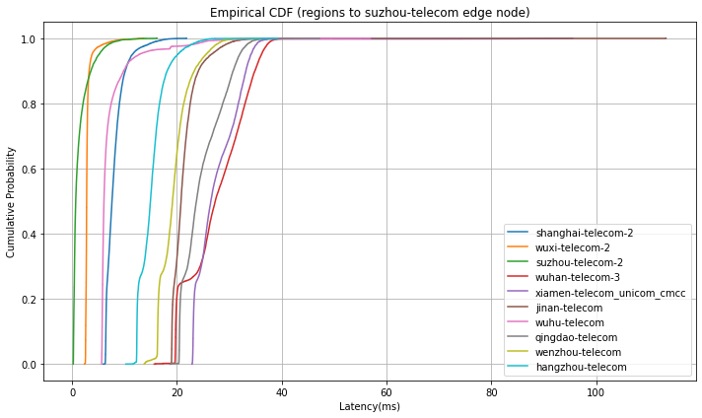
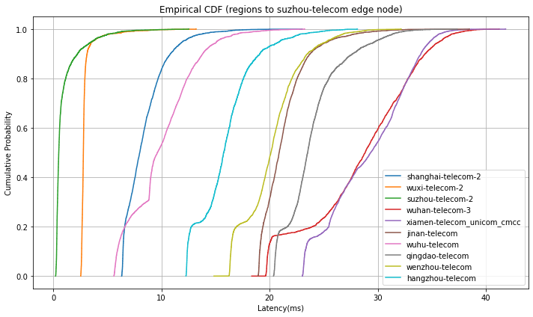
Regions to Suzhou-telecom (1 week)
5.31-6.7
6.14-6.21
6.7-6.14
6.21-6.28

Slide 5
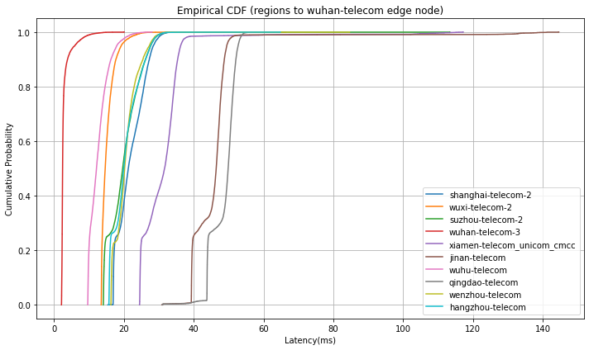
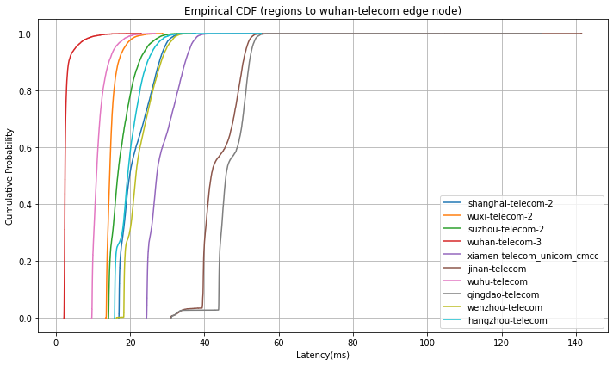
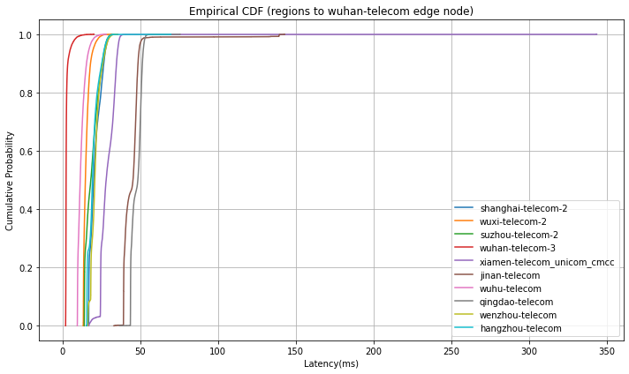
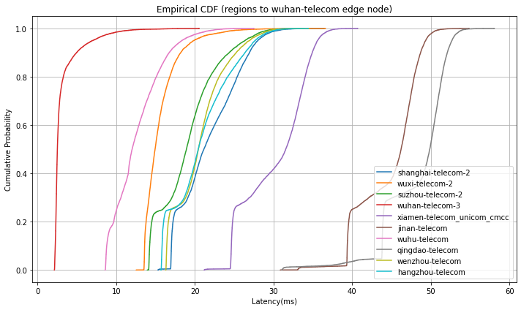
Regions to Wuhan-telecom (1 week)
6.14-6.21
5.31-6.7
6.21-6.28
6.7-6.14

Slide 6
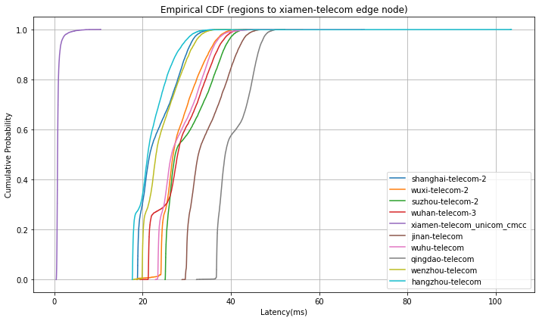
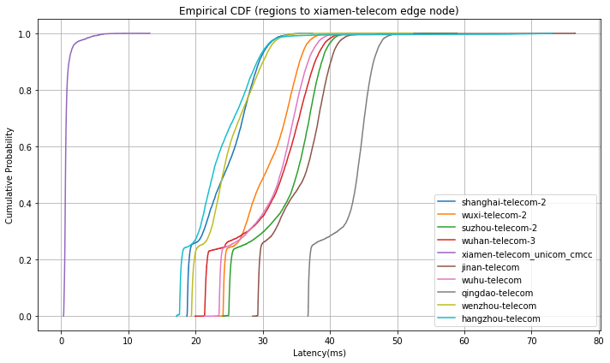
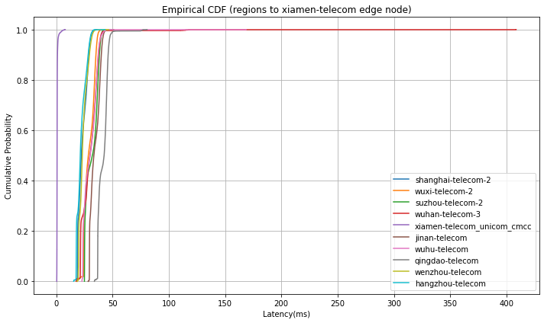
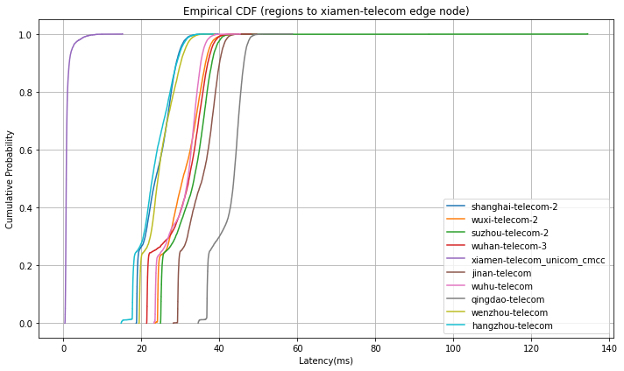
Regions to Xiamen-telecom (1 week)
5.31-6.7
6.14-6.21
6.21-6.28
6.7-6.14

Slide 7
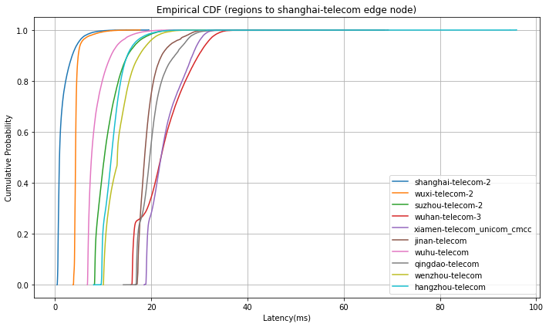
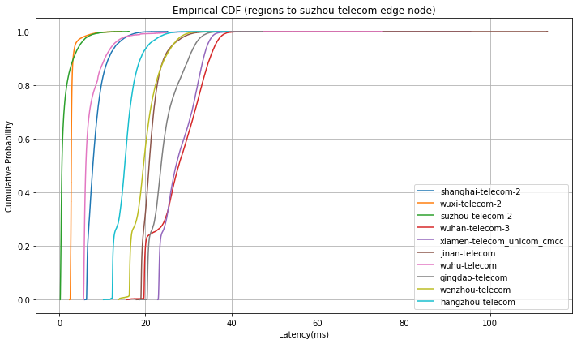
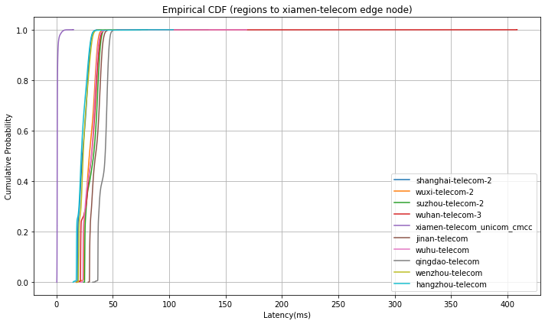
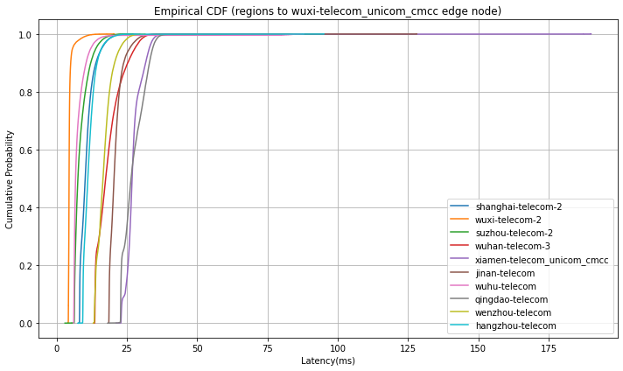
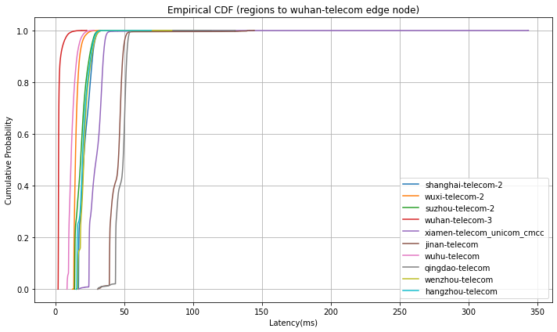
With the whole dataset
Suzhou
Shanghai
Xiamen
Wuxi
Wuhan

Slide 8
Average latency
variance
5.31-6.7
[[2.0, 5.0, 11.0, 22.0, 22.0, 21.0, 8.0, 21.0, 17.0, 12.0],
[12.0, 5.0, 8.0, 18.0, 27.0, 21.0, 8.0, 27.0, 18.0, 12.0],
[9.0, 3.0, 2.0, 27.0, 28.0, 22.0, 7.0, 24.0, 21.0, 16.0],
[22.0, 15.0, 18.0, 3.0, 29.0, 44.0, 12.0, 48.0, 23.0, 20.0],
[24.0, 29.0, 31.0, 29.0, 1.0, 35.0, 29.0, 41.0, 25.0, 23.0]]
[[3.652, 0.493, 5.901, 21.529, 8.793, 9.523, 2.908, 9.186, 9.317, 9.03],
[9.522, 0.528, 4.546, 17.042, 8.336, 5.401, 2.837, 9.463, 9.783, 8.852],
[7.805, 0.444, 1.811, 28.802, 14.164, 5.393, 3.023, 6.852, 12.74, 7.35],
[17.691, 2.795, 11.345, 2.099, 16.139, 24.503, 4.533, 18.64, 14.609, 12.039],
[18.39, 17.162, 25.862, 31.802, 0.346, 19.306, 22.169, 14.21, 16.265, 18.073]]
6.7-6.14
[[2.0, 5.0, 12.0, 23.0, 23.0, 20.0, 9.0, 21.0, 14.0, 12.0],
[11.0, 5.0, 9.0, 18.0, 28.0, 21.0, 8.0, 28.0, 17.0, 12.0],
[9.0, 3.0, 2.0, 28.0, 28.0, 22.0, 8.0, 25.0, 20.0, 16.0],
[22.0, 16.0, 20.0, 3.0, 30.0, 45.0, 13.0, 48.0, 22.0, 20.0],
[24.0, 30.0, 32.0, 30.0, 1.0, 35.0, 31.0, 42.0, 24.0, 23.0]]
[[1.364, 0.829, 9.723, 24.187, 9.155, 4.486, 7.116, 16.826, 6.369, 4.455],
[4.259, 0.901, 7.421, 18.423, 34.462, 5.384, 4.69, 22.393, 5.803, 4.146],
[3.489, 0.743, 2.919, 31.498, 21.269, 7.148, 14.061, 15.309, 8.537, 6.527],
[13.459, 4.783, 19.166, 1.839, 28.835, 91.766, 6.429, 9.783, 10.301, 12.811],
[14.89, 20.563, 29.7, 76.405, 0.324, 17.803, 34.538, 21.112, 12.981, 15.508]]
6.14-6.21
[[2.0, 5.0, 12.0, 23.0, 24.0, 20.0, 9.0, 21.0, 12.0, 13.0],
[11.0, 5.0, 10.0, 19.0, 28.0, 22.0, 8.0, 29.0, 17.0, 12.0],
[9.0, 3.0, 2.0, 29.0, 29.0, 22.0, 8.0, 26.0, 21.0, 16.0],
[22.0, 16.0, 20.0, 3.0, 32.0, 46.0, 13.0, 49.0, 21.0, 21.0],
[25.0, 31.0, 34.0, 31.0, 1.0, 36.0, 32.0, 43.0, 25.0, 24.0]]
[[1.98, 0.905, 10.263, 28.087, 13.061, 4.246, 4.903, 10.308, 3.887, 5.523],
[5.485, 0.971, 8.381, 21.554, 7.49, 6.253, 4.205, 17.644, 6.997, 5.193],
[4.474, 0.847, 3.132, 35.758, 16.643, 6.189, 4.198, 15.411, 10.279, 8.765],
[15.244, 4.355, 20.199, 2.218, 71.25, 85.931, 7.728, 11.921, 11.43, 14.937],
[16.86, 18.62, 27.925, 38.451, 0.544, 19.067, 25.45, 14.144, 14.983, 27.003]]
6.21-6.28
[[2.0, 5.0, 12.0, 24.0, 25.0, 19.0, 10.0, 20.0, 13.0, 13.0],
[11.0, 5.0, 9.0, 20.0, 28.0, 22.0, 10.0, 28.0, 17.0, 12.0],
[9.0, 3.0, 1.0, 29.0, 30.0, 22.0, 10.0, 24.0, 21.0, 16.0],
[22.0, 16.0, 20.0, 4.0, 31.0, 45.0, 13.0, 49.0, 21.0, 21.0],
[24.0, 31.0, 33.0, 31.0, 1.0, 35.0, 31.0, 43.0, 25.0, 24.0]]
[[2.197, 0.969, 7.329, 26.63, 15.451, 4.364, 5.891, 6.783, 4.823, 6.388],
[5.885, 1.003, 5.791, 21.972, 10.139, 8.008, 100.337, 13.442, 7.772, 5.84],
[3.769, 0.6, 1.578, 25.234, 14.817, 4.787, 9.245, 7.449, 7.465, 7.189],
[14.261, 5.209, 14.312, 3.198, 16.603, 14.687, 9.591, 17.073, 11.079, 14.897],
[15.306, 21.74, 28.82, 35.504, 0.781, 17.137, 20.314, 13.71, 15.086, 18.182]]
Average is very close, but sometimes variance changes a lot (which is unavoidable in real
scenarios)

Slide 9
25% percentile
50% median
5.31-6.7
[[0.702, 4.205, 8.714, 16.58, 19.455, 17.916, 6.947, 17.712, 13.357, 10.11], [8.622, 4.323, 6.639, 14.114, 25.165, 19.099, 6.283, 24.135, 15.424, 9.694], [6.813, 2.707, 0.423, 20.576, 23.633, 19.508, 5.818, 21.168, 16.893, 12.847], [17.607, 13.874, 14.807, 2.349, 24.96, 39.928, 10.048, 44.188, 18.804, 16.5], [19.38, 24.721, 25.72, 21.94, 0.623, 30.489, 24.08, 37.192, 20.404, 18.206]]
[[1.071, 4.295, 9.47, 20.916, 21.061, 18.947, 7.259, 19.362, 15.143, 11.228], [9.876, 4.416, 7.102, 16.45, 26.317, 20.151, 6.524, 26.108, 17.413, 10.689], [7.858, 2.776, 0.56, 26.257, 25.872, 20.652, 6.023, 23.087, 19.315, 15.021], [19.851, 14.48, 16.66, 2.457, 27.152, 41.842, 10.916, 45.782, 21.524, 19.325], [21.617, 26.913, 27.384, 27.935, 0.717, 32.616, 26.545, 38.701, 23.04, 21.158]]
6.7-6.14
[[0.614, 4.18, 8.72, 16.943, 19.48, 17.571, 6.985, 17.52, 12.374, 10.103], [8.523, 4.304, 6.669, 14.139, 25.651, 19.08, 6.278, 23.225, 14.5, 9.734], [6.685, 2.679, 0.415, 20.975, 23.652, 19.504, 5.819, 20.946, 16.69, 12.739], [17.579, 13.838, 14.701, 2.333, 24.863, 39.941, 10.133, 44.157, 18.648, 16.41], [19.416, 24.522, 25.495, 22.597, 0.567, 29.96, 24.321, 37.149, 20.441, 18.151]]
[[0.77, 4.294, 10.518, 21.579, 21.247, 18.445, 7.435, 19.834, 13.585, 11.496], [9.782, 4.422, 7.87, 16.974, 26.851, 20.295, 6.57, 26.048, 16.08, 10.937],
[7.603, 2.77, 0.686, 27.31, 26.463, 20.784, 6.073, 23.719, 19.156, 14.943], [20.155, 14.834, 18.312, 2.447, 28.194, 45.424, 11.516, 48.541, 20.91, 19.346], [22.212, 28.409, 31.997, 29.823, 0.651, 33.341, 30.047, 42.434, 23.072, 21.256]]
6.14-6.21
[[0.738, 4.192, 8.941, 17.013, 19.506, 17.624, 7.04, 18.038, 10.347, 10.214], [8.729, 4.304, 6.725, 14.436, 26.247, 19.123, 6.337, 23.549, 14.292, 9.773], [6.737, 2.678, 0.409, 21.963, 23.694, 19.513, 5.855, 21.328, 16.785, 12.923], [17.833, 13.82, 15.138, 2.337, 25.484, 39.903, 10.197, 44.205, 18.288, 16.284], [19.401, 25.811, 26.992, 24.421, 0.57, 29.803, 25.077, 37.397, 20.659, 19.156]]
[[0.916, 4.302, 11.004, 22.56, 22.368, 18.667, 7.675, 20.21, 10.956, 11.878], [10.241, 4.414, 8.123, 17.685, 27.14, 20.54, 6.802, 27.737, 16.148, 11.203], [7.889, 2.768, 0.679, 29.774, 28.996, 21.068, 6.239, 24.48, 19.926, 15.561], [21.272, 14.66, 19.661, 2.46, 31.64, 46.439, 12.159, 49.854, 20.225, 19.968], [24.26, 30.278, 35.053, 32.934, 0.659, 36.307, 32.606, 44.074, 24.052, 22.574]]
6.21-6.28
[[1.782, 4.247, 12.366, 26.956, 27.44, 19.765, 10.21, 20.743, 13.015, 13.721], [11.871, 4.569, 9.358, 21.843, 28.501, 22.006, 9.219, 30.046, 18.144, 13.154], [9.345, 2.888, 0.913, 32.205, 32.268, 22.19, 11.916, 24.924, 21.64, 17.19], [24.718, 16.334, 21.186, 2.978, 33.643, 47.607, 14.481, 51.159, 22.418, 23.283], [27.108, 34.465, 36.366, 35.2, 0.924, 38.549, 33.851, 45.139, 27.451, 26.596]]
[[0.981, 4.095, 10.377, 22.973, 23.734, 18.385, 8.274, 19.398, 11.414, 12.109], [10.523, 4.408, 7.524, 18.292, 26.925, 20.576, 7.297, 26.327, 16.529, 11.546], [7.998, 2.787, 0.513, 28.839, 29.345, 20.886, 9.629, 23.524, 20.124, 15.759], [21.143, 14.936, 18.922, 2.511, 31.548, 46.222, 12.016, 49.865, 20.435, 20.427], [23.614, 30.598, 33.503, 32.201, 0.701, 35.623, 31.886, 43.69, 24.225, 22.767]]
Both 25% percentile and median are close.

Slide 11
75% percentile
5.31-6.7
[[2.693, 4.454, 10.753, 24.195, 23.334, 21.109, 7.956, 21.102, 18.085, 12.666], [12.697, 4.567, 8.041, 19.576, 27.773, 21.737, 7.079, 28.534, 19.596, 12.026], [10.432, 2.896, 0.912, 30.763, 29.925, 22.291, 6.586, 24.609, 22.569, 16.691], [24.819, 15.305, 19.497, 2.711, 31.897, 48.515, 12.214, 50.735, 25.212, 21.967], [26.967, 31.164, 34.859, 33.214, 0.858, 38.135, 32.457, 44.273, 27.248, 24.446]]
6.7-6.14
[[1.262, 4.485, 13.023, 25.14, 23.143, 19.596, 8.75, 22.008, 15.195, 12.857], [10.992, 4.608, 10.071, 19.996, 28.082, 21.592, 7.433, 31.167, 17.633, 12.256], [8.698, 2.911, 1.654, 32.144, 30.992, 22.126, 6.935, 27.713, 20.764, 16.283], [23.748, 16.35, 22.102, 2.693, 33.059, 47.462, 13.36, 50.411, 22.859, 21.565], [26.619, 33.474, 36.539, 35.017, 0.756, 38.259, 35.088, 44.772, 25.931, 24.699]]
75% percentile is generally close although compared with 25% and 50%, it has a relatively
larger deviation. This is caused by unexpected extreme RTT values.
6.14-6.21
[[1.634, 4.465, 13.357, 26.717, 25.761, 19.933, 9.4, 22.146, 12.4, 13.314], [11.498, 4.568, 10.484, 21.067, 28.641, 21.876, 8.293, 31.825, 17.752, 12.68], [9.137, 2.886, 1.82, 33.301, 32.237, 22.425, 7.688, 28.213, 21.776, 17.086], [25.075, 16.014, 22.962, 2.73, 34.01, 47.676, 14.077, 51.077, 22.241, 22.812], [27.569, 33.885, 37.328, 35.909, 0.811, 38.711, 35.059, 45.39, 27.422, 26.651]]
6.21-6.28
[[0.748, 3.993, 8.782, 18.113, 19.613, 17.443, 7.119, 17.678, 10.418, 10.172], [8.91, 4.305, 6.679, 14.554, 25.946, 19.139, 6.403, 23.826, 14.237, 9.803],
[6.834, 2.697, 0.37, 25.322, 25.822, 19.648, 7.35, 22.246, 18.452, 14.177], [17.691, 13.977, 15.873, 2.35, 25.033, 39.971, 10.04, 44.025, 16.979, 16.755], [19.363, 26.202, 26.363, 23.137, 0.582, 30.092, 25.264, 37.524, 20.826, 18.882]]

Slide 12
Bandwidth (demands)
1. sum up all the uplink downlink traffic in one city 2. If not possible, find other datasets

Slide 13
demands
list_city = ['shanghai', 'wuxi', 'suzhou', 'wuhan', 'xiamen', 'jinan', 'wuhu', 'qingdao', 'wenzhou', 'hangzhou']
uplink
downlink
5.31-6.7
[0.15388799 0.00428857 0.01314729 0.48028099 0.03025558
0.22179815 0.00940313 0.03860784 0.00845509 0.03987537]
[0.18697643 0.00271161 0.01934236 0.46665019 0.04348361
0.18876667 0.01209583 0.03367072 0.00291587 0.04338671]
6.7-6.14
[0.14507702 0.00414235 0.01223504 0.55090125 0.03162602
0.1571676 0.00997686 0.03608079 0.00874303 0.04405004]
[0.17547588 0.00273265 0.01790011 0.53540328 0.04328443
0.1313843 0.01251594 0.02982227 0.00352425 0.04795688]
6.14-6.21
[0.14884649 0.00344497 0.01309836 0.48629006 0.03638745
0.21164971 0.01169561 0.03186416 0.00901672 0.04770647]
[0.18473225 0.00267733 0.01940887 0.46625571 0.04905677
0.17384131 0.01509724 0.03147051 0.00379588 0.05366414]
6.21-6.28
[0.15238484 0.00390968 0.0126879 0.51557201 0.03709588
0.18212424 0.00968815 0.02669452 0.00873791 0.05110486]
[0.18566854 0.00278476 0.01894201 0.49343929 0.05021555
0.14855726 0.01300492 0.02943232 0.00349387 0.05446149]
round
[0.15 0.004 0.01 0.48-0.55 0.03-0.04
0.16-0.22 0.01 0.03-0.04 0.01 0.04-0.05]
[0.18 0.003 0.02 0.47-0.54 0.04-0.05
0.13-0.19 0.01 0.03 0.003-0.004 0.04-0.05]

Slide 14
population
[0.15 0.004 0.01 0.48-0.55 0.03-0.04
0.16-0.22 0.01 0.03-0.04 0.01 0.04-0.05]
City | Population | Proportion | City | Population | Proportion
shanghai | 21,909,814 | 0.30 | jinan | 5,648,162 | 0.08
wuxi | 3,956,985 | 0.05 | wuhu | 1,598,165 | 0.02
suzhou | 5,892,892 | 0.08 | qingdao | 6,165,279 | 0.09
wuhan | 10,494,879 | 0.15 | wenzhou | 2,582,017 | 0.04
xiamen | 4,617,251 | 0.06 | hangzhou | 9,236,032 | 0.13
uplink
downlink
Population Census © 2020-11-01
https://www.citypopulation.de/en/china/cities/
[0.18 0.003 0.02 0.47-0.54 0.04-0.05
0.13-0.19 0.01 0.03 0.003-0.004 0.04-0.05]

Slide 15
26 July
1. get the proportion of demands according to the cores of PM in each city 2. Look at the repo, get the best extreme value distribution method (how much data should be used to fit?)
3. How to apply the simulation method in the paper to ours? (repo not available)

Slide 16
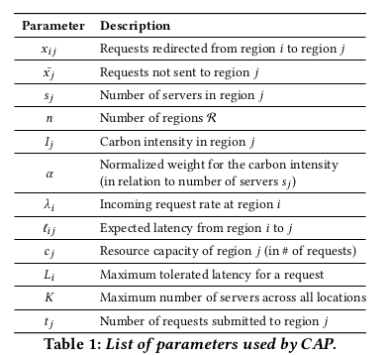
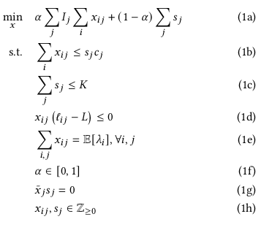
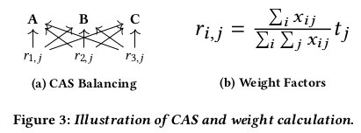
CAP & CAS

Slide 17
CASPER: K8S
Environment Cluster: 16 servers with 16-cores Intel Xeon processors and 32GB of memory
Each service: 32 GB of content 1000 requests/server max.
Requests
Carbon intensity (#electricitymap)
Request distribution matrix
CAS (Traefik)
Load balancer
Scheduler
CAP (PuLP lib)
Solve optimization
Distributing requests proportionally
Workload (#wikimedia dataset)
Provisioning
Node 1 (Kiwix)
Worker node 1
Node 2 (Kiwix)
Worker node 2
Node 3 (Kiwix)
Worker node 3
Node 4 (Kiwix)
Worker node 4
Node 5 (Kiwix)
Worker node 5
Node 6 (Kiwix)
Worker node 6
Regions
Problem: 1. In simulation, how do they measure network latency when evaluating performance? There is a difference between reality and simulation. Need to see the code.

Slide 18
Solution: K8S
Region 1 (Request generator)
Worker node 6
Region 2 (Request generator)
Worker node 7
Region 3 (Request generator)
Worker node 8
Region 4 (Request generator)
Worker node 9
Request distribution matrix
(Traefik)
Load balancer
Scheduler
Requests
Demands
Region 5 (Request generator)
Worker node 10
(CPLEX)
Solve optimization
Regions
weight/possibility
Region 6 (Request generator)
Worker node 11
Average network latency
Whether deploy or not
Region 7 (Request generator)
Worker node 12
Region 8 (Request generator)
Worker node 13
Region 9 (Request generator)
Worker node 14
Region 10 (Request generator)
Worker node 15
Node 1 (App)
Worker node 1
Node 2 (App)
Worker node 2
Node 3 (App)
Worker node 3
Node 4 (App)
Worker node 4
Node 5 (App)
Worker node 5
Edge nodes
Problem: 1. How to measure network latency?

Slide 19
Overview of the simulation for evaluating placement of edge computing apps
“A robust optimization approach for placement of applications in edge computing considering latency uncertainty”
Jaehee Jeong, Gopika Premsankar, Bissan Ghaddar, Sasu Tarkoma
31 July

Slide 20
Content
1. Problem Description 2. Deterministic optimization problem 3. Workflow 4. CASPER & possible new solution

Slide 21
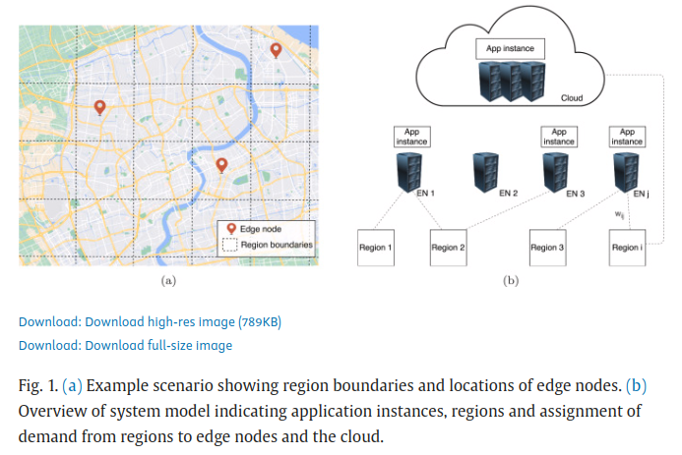
1. Problem Description

Slide 22
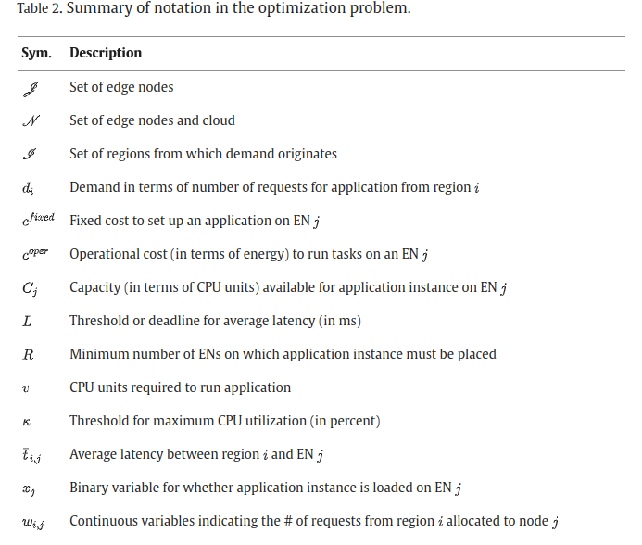
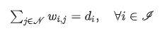
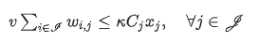
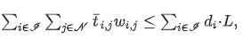
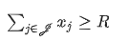
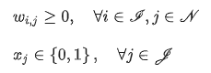
2. Deterministic optimization problem
Constraints:
1. Traffic allocation constraint
2. Capacity constraint
3. Latency constraint
4. Resilience constraint
5. Resilience constraint

Slide 23
3. Workflow
Simulation
Data processing
Real latency
Small-sized network: 10 regions & 5 ENs
Best distribution methods & parameters
Data processing
Average latency
Network scenario
Solve optimization
Solution
Demands
Performance analysis
average_latency_sim

Slide 24
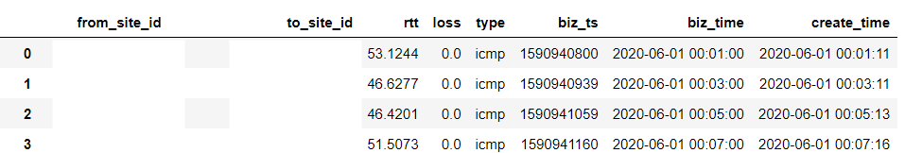
Data processing
Average latency
Raw data:
Result:
dc_ids = ['shanghai-telecom', 'wuxi-telecom_unicom_cmcc', 'suzhou-telecom', 'wuhan-telecom', 'xiamen-telecom']
region_ids = ['shanghai-telecom-2', 'wuxi-telecom-2', 'suzhou-telecom-2', 'wuhan-telecom-3', 'xiamen-telecom_unicom_cmcc', 'jinan-telecom', 'wuhu-telecom', 'qingdao-telecom', 'wenzhou-telecom', 'hangzhou-telecom']

Slide 25
Regions to Shanghai-telecom (1 week)
31/5-7/6
14/6-21/6
7/6-14/6
21/6-28/6

Slide 26
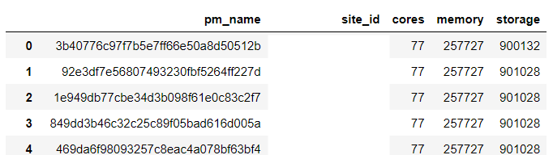
Data processing
Demands from each region
Raw data:
Result:
{'shanghai': 0.304, 'wuxi': 0.065, 'suzhou': 0.057, 'wuhan': 0.213, 'xiamen': 0.059, 'jinan': 0.094, 'wuhu': 0.037, 'qingdao': 0.088, 'wenzhou': 0.007, 'hangzhou': 0.076}
Back

Slide 27
Data processing
Real latency
Raw data:
Distribution list:
distributions_to_test = ['beta', 'burr12', 'fatiguelife', 'fisk', 'expon', 'gamma', 'genextreme',
'genpareto', 'invgauss', 'logistic', 'lognorm', 'levy_stable', 'nakagami',
'rice', 'rayleigh', 't', 'skewnorm']

Slide 28
4. CASPER
Environment Cluster: 16 servers with 16-cores Intel Xeon processors and 32GB of memory
Each service: 32 GB of content 1000 requests/server max.
Requests
Carbon intensity (#electricitymap)
Request distribution matrix
CAS (Traefik)
Load balancer
Scheduler
CAP (PuLP lib)
Solve optimization
Distributing requests proportionally
Workload (#wikimedia dataset)
Provisioning
Node 1 (Kiwix)
Worker node 1
Node 2 (Kiwix)
Worker node 2
Node 3 (Kiwix)
Worker node 3
Node 4 (Kiwix)
Worker node 4
Node 5 (Kiwix)
Worker node 5
Node 6 (Kiwix)
Worker node 6
Regions

Slide 29
4. Another solution inspired by CASPER
Region 1 (Request generator)
Worker node 6
Region 2 (Request generator)
Worker node 7
Region 3 (Request generator)
Worker node 8
Region 4 (Request generator)
Worker node 9
Request distribution matrix
(Traefik)
Load balancer
Scheduler
Requests
Demands
Region 5 (Request generator)
Worker node 10
(CPLEX)
Solve optimization
Regions
weight
Region 6 (Request generator)
Worker node 11
Average network latency
Whether deploy or not
Region 7 (Request generator)
Worker node 12
Region 8 (Request generator)
Worker node 13
Region 9 (Request generator)
Worker node 14
Region 10 (Request generator)
Worker node 15
Node 1 (App)
Worker node 1
Node 2 (App)
Worker node 2
Node 3 (App)
Worker node 3
Node 4 (App)
Worker node 4
Node 5 (App)
Worker node 5
Edge nodes
Problem: 1. How to implement request generators? 2. How to measure network latency? (need to see the code)

Slide 30
Thank you!

Slide 31
19 Aug
1. plot CDF for the selected 4 distributions 2. Upload current progress onto a new repo, including README.md, comments and plots
3. how network latency is measured and how demands are generated in CASPER

Slide 32
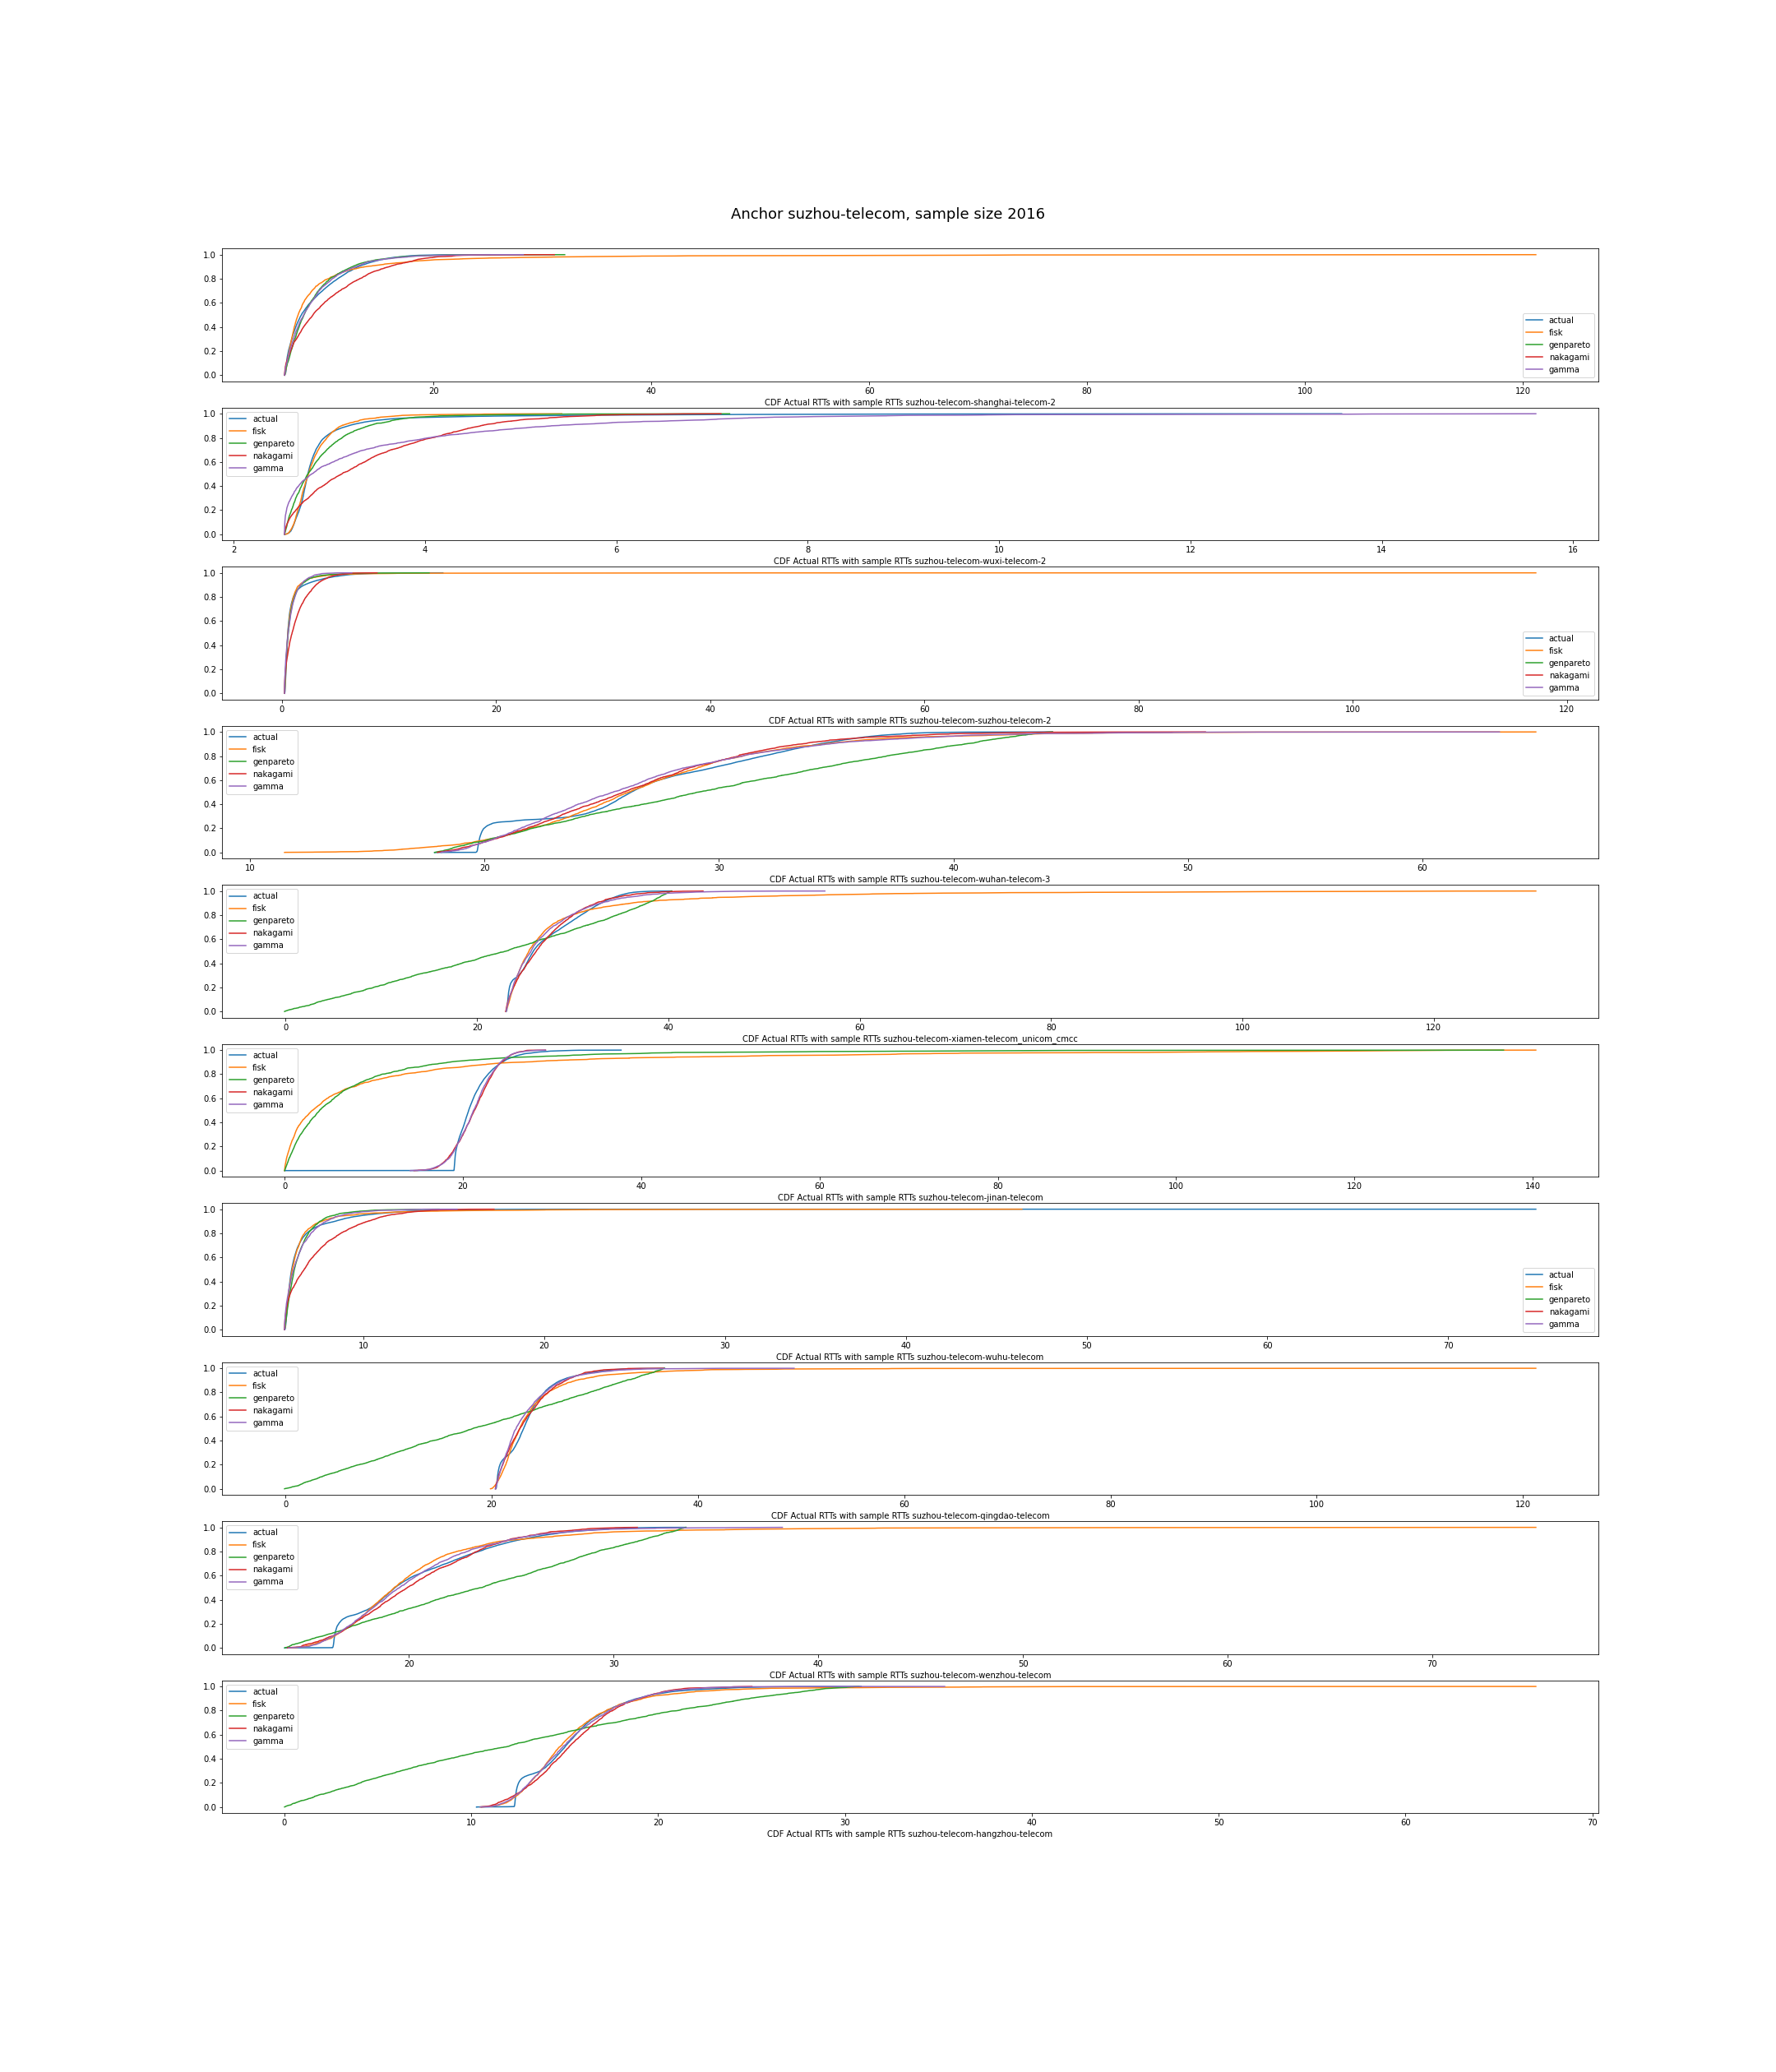
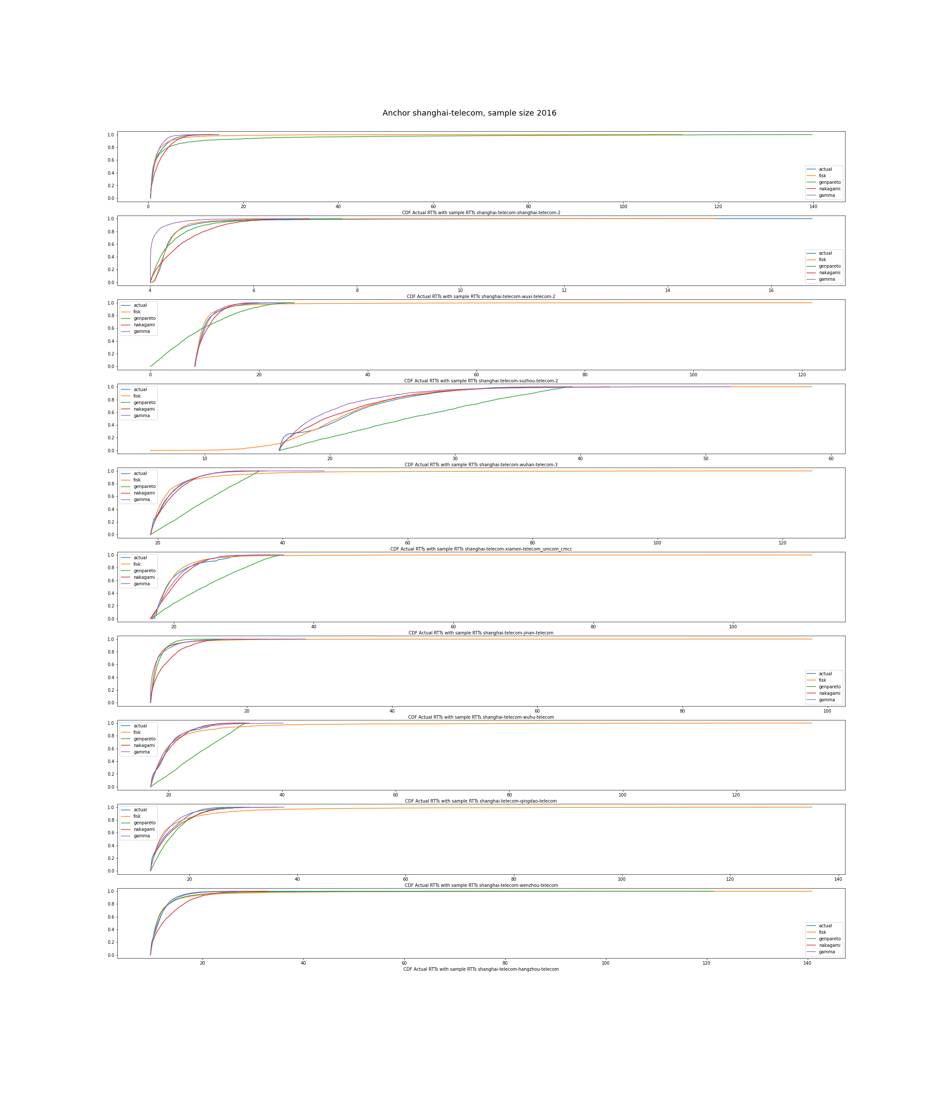
Shanghai
Suzhou

Slide 33
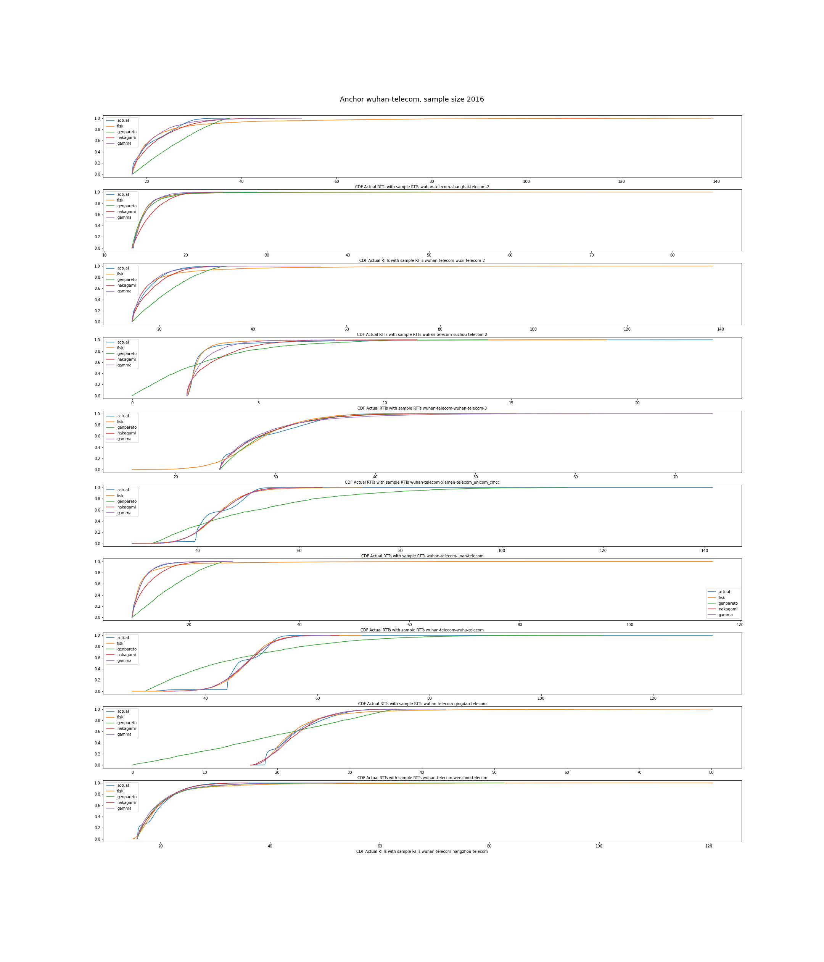
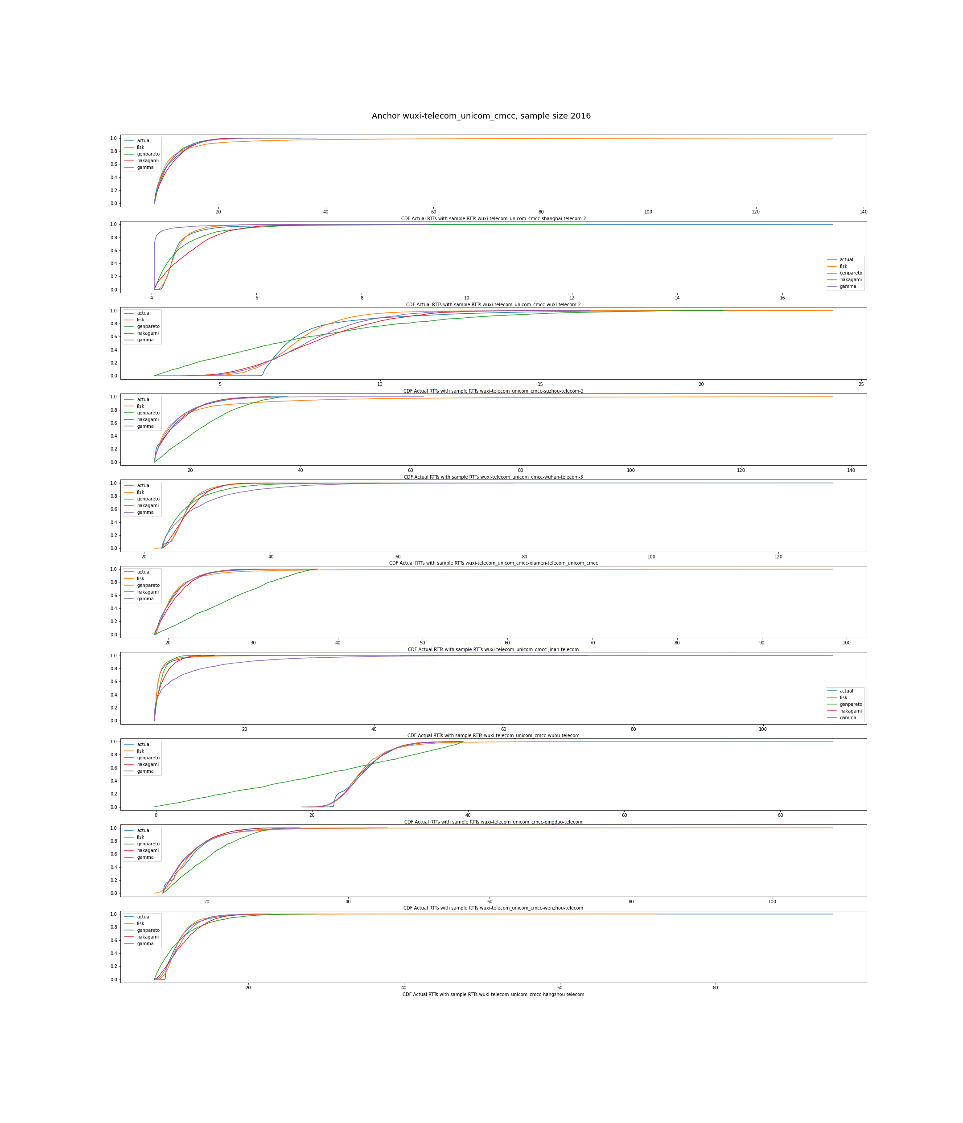
Wuhan
Wuxi

Slide 34
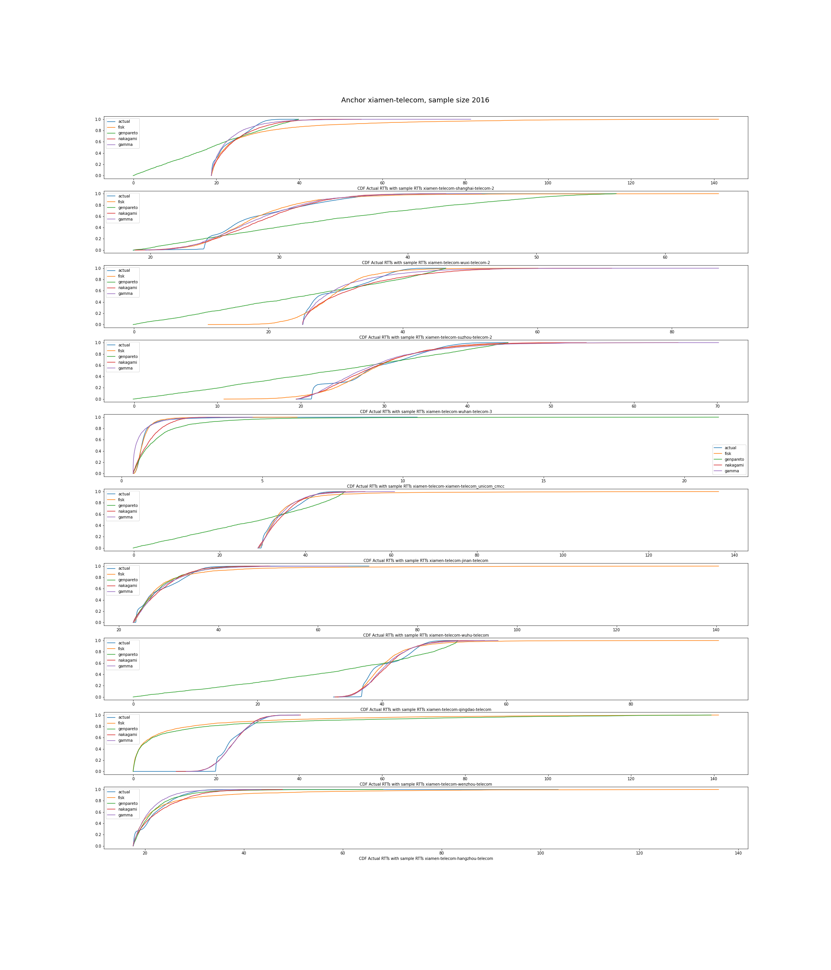
Xiamen
Findings:
1. The effect of Genpareto isn't ideal.
2. Real data & samples might have a difference in the
length of the tails.
3. Fisk is not ideal in some situations:
a. from wenzhou-telecom to xiamen-telecom
b. from jinan-telecom to suzhou-telecom
Question:
1. For Gumbel, if we need to fit for the best
parameters, since it’s using fixed parameters now?

Slide 35
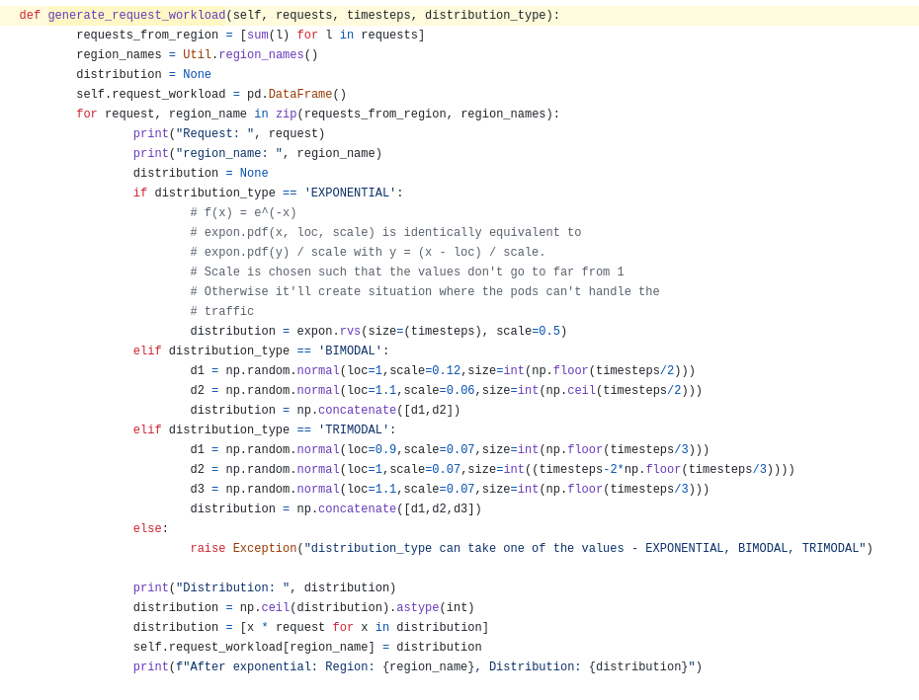
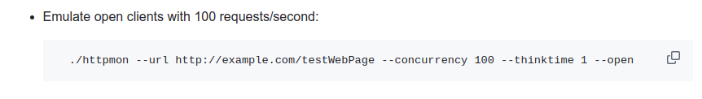
Demands
It’s generated by an exponential distribution.
“Parameters to generate the distributions are selected such that the upper limit of the generated values is approximately 1.5× the request rate for the hour.”
It uses Httpmon, which enables the main node to send # requests/second.

Slide 36
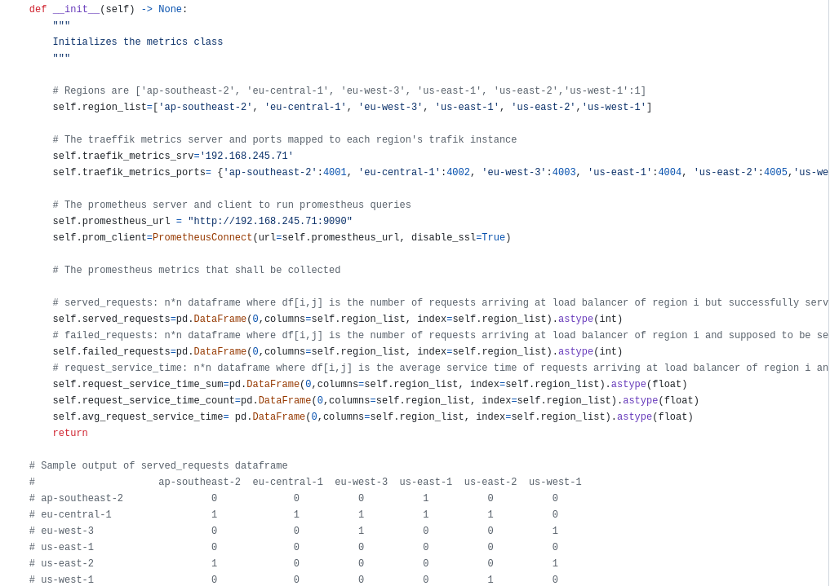
Network latency
It connects Prometheus as a metrics collector with each load balancer. It provides an API to observe the metrics.

Slide 37
30 Aug
1. fit gumbel to find out the parameters 2. put the data generated from the distribution into simulation and make it work

Slide 38
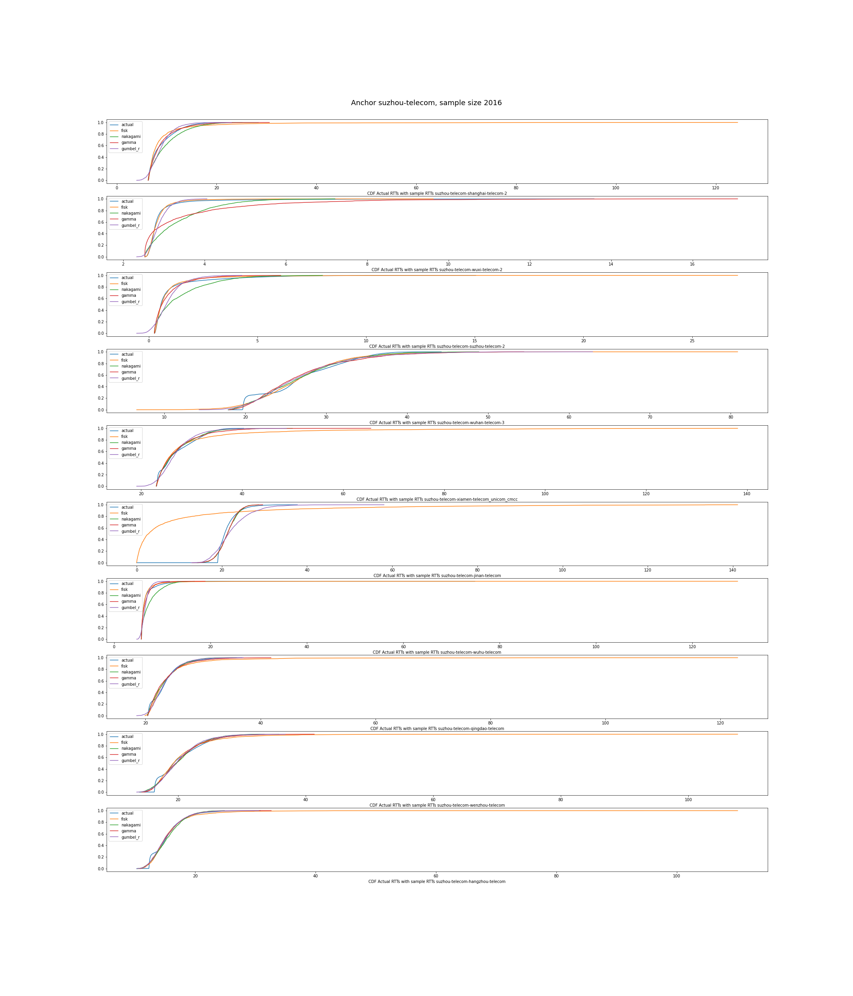
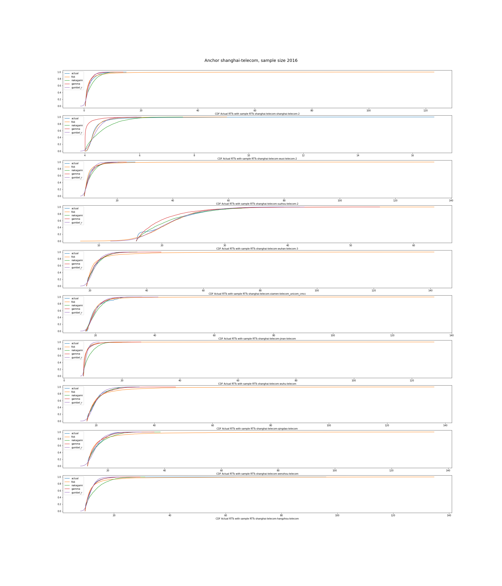
Shanghai
Suzhou

Slide 39
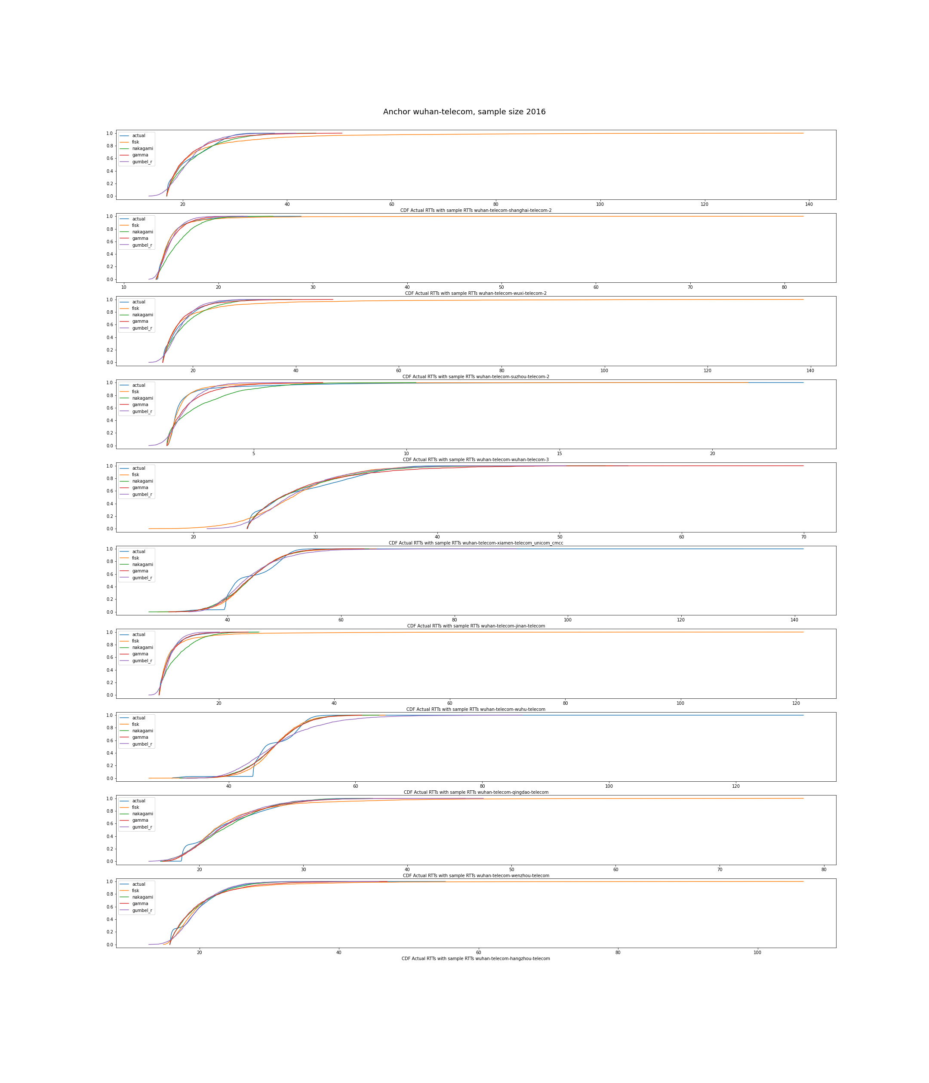
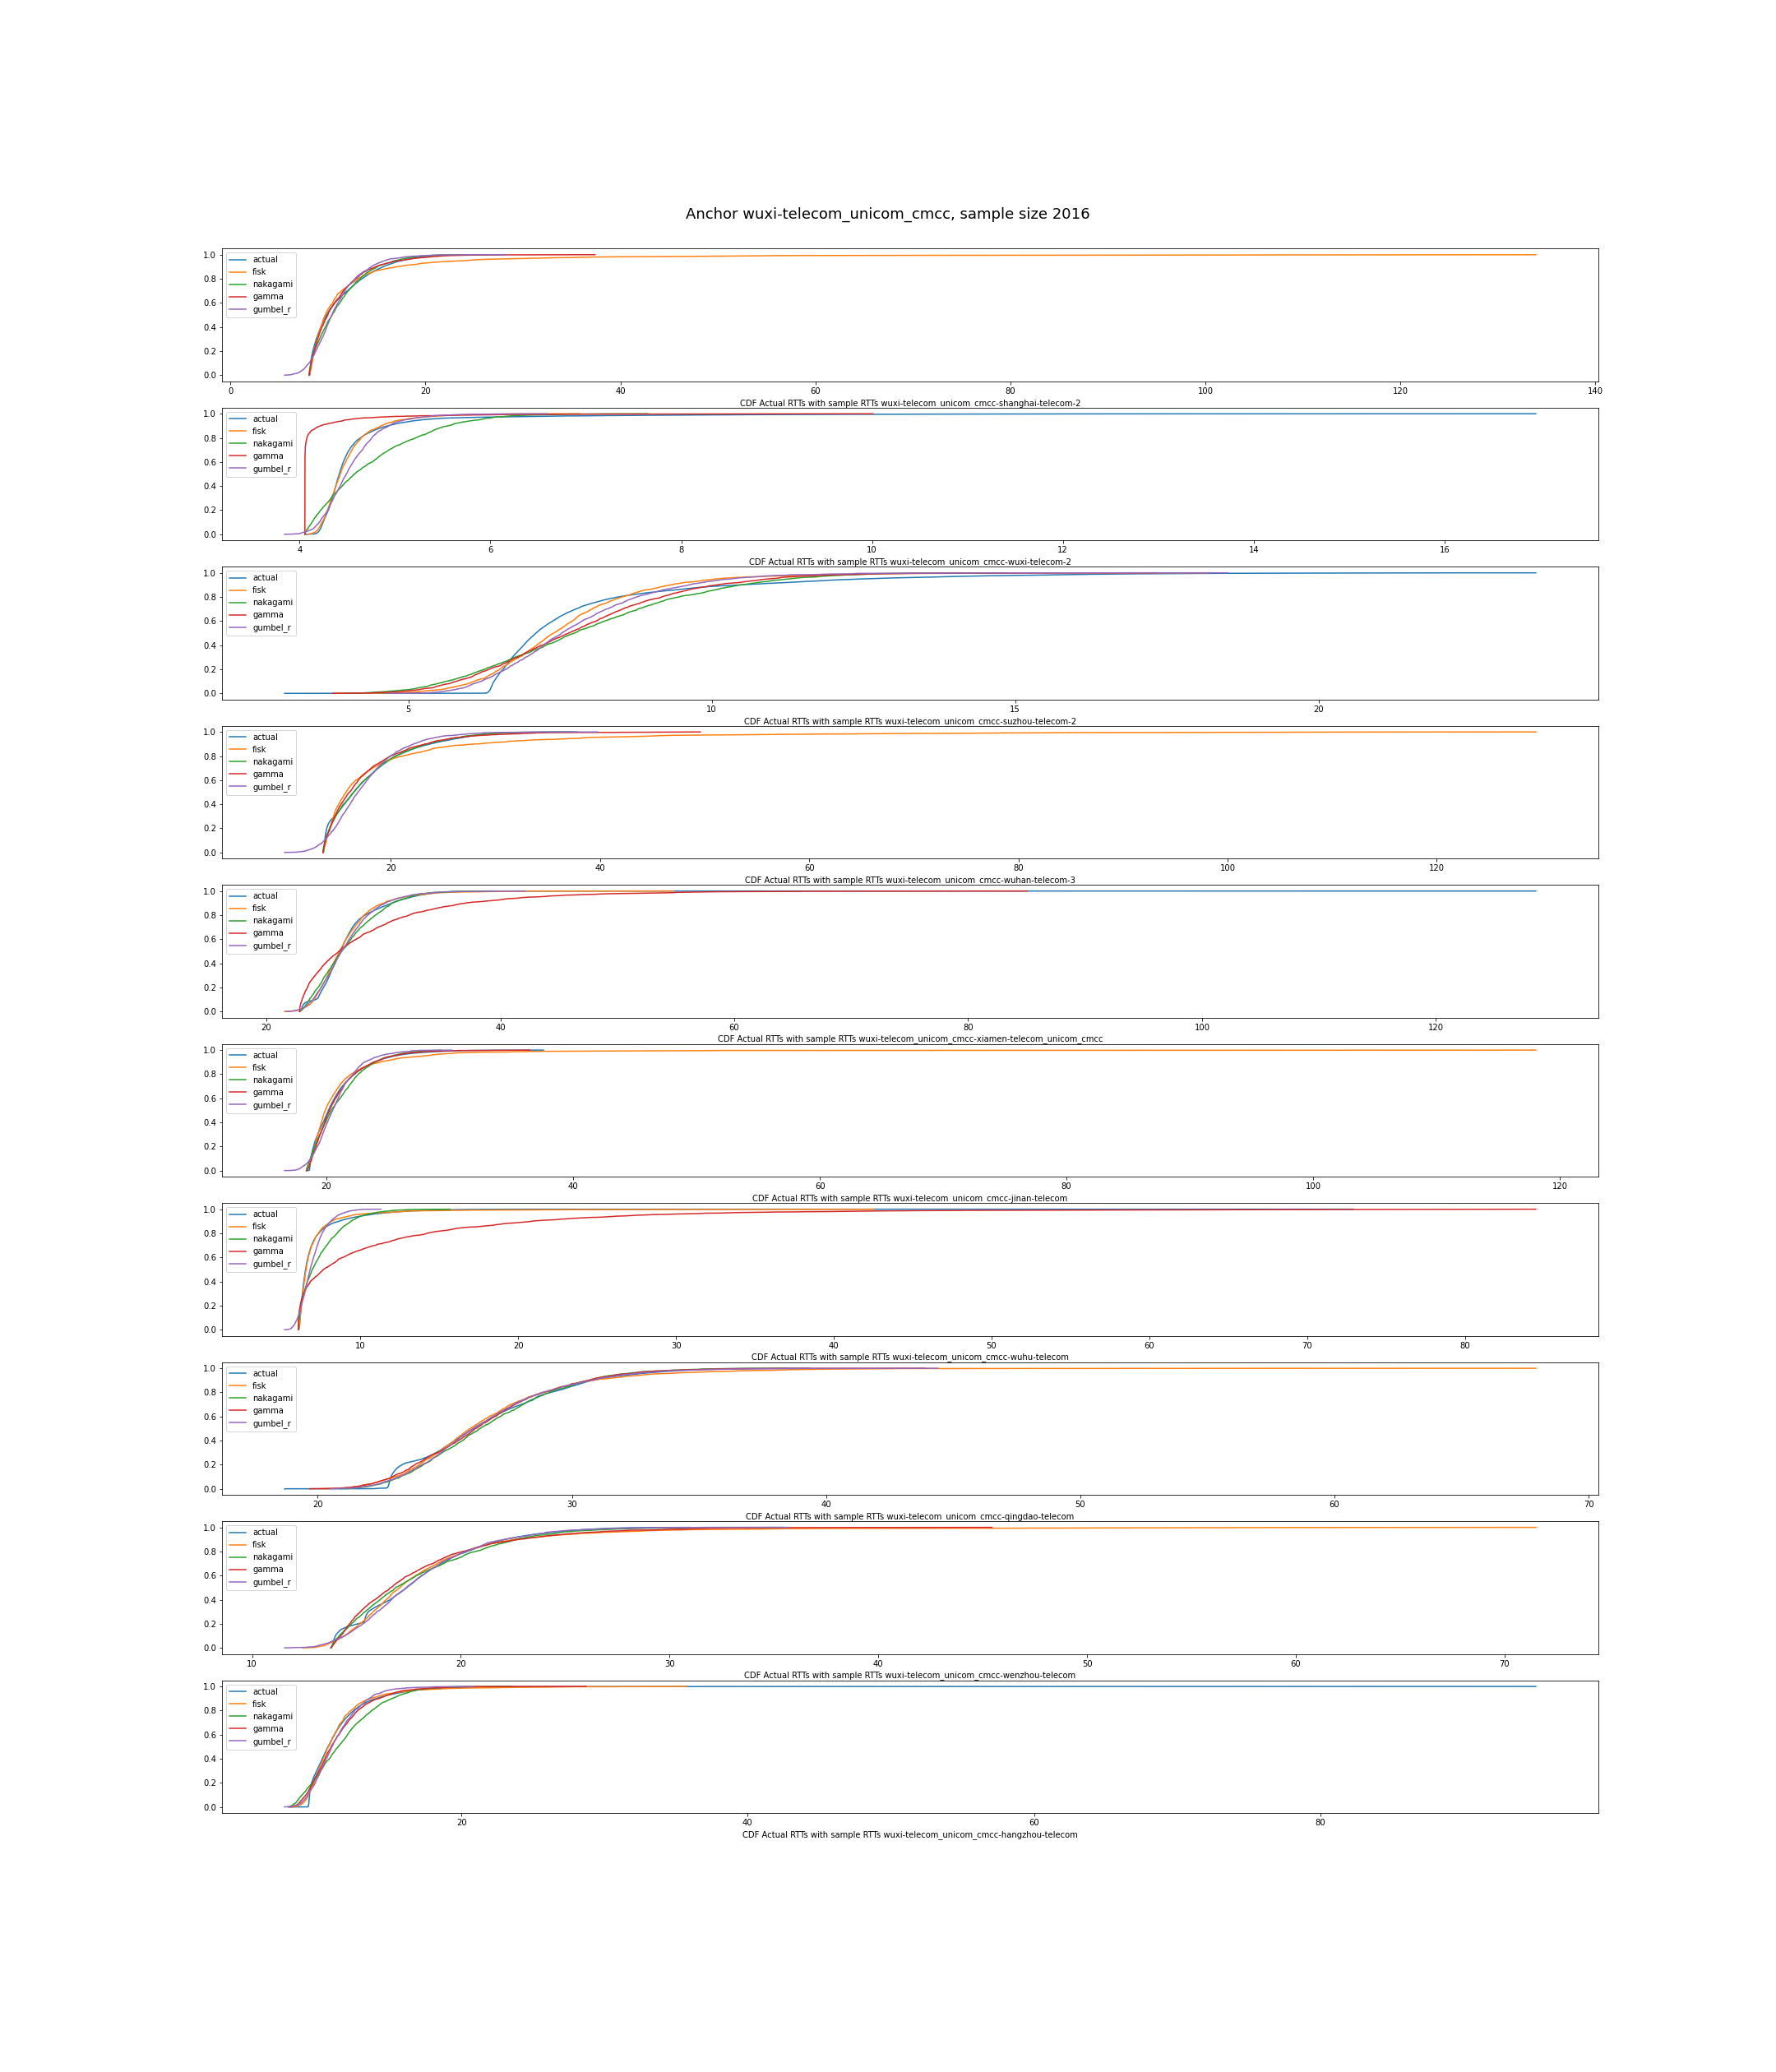
Wuhan
Wuxi

Slide 40
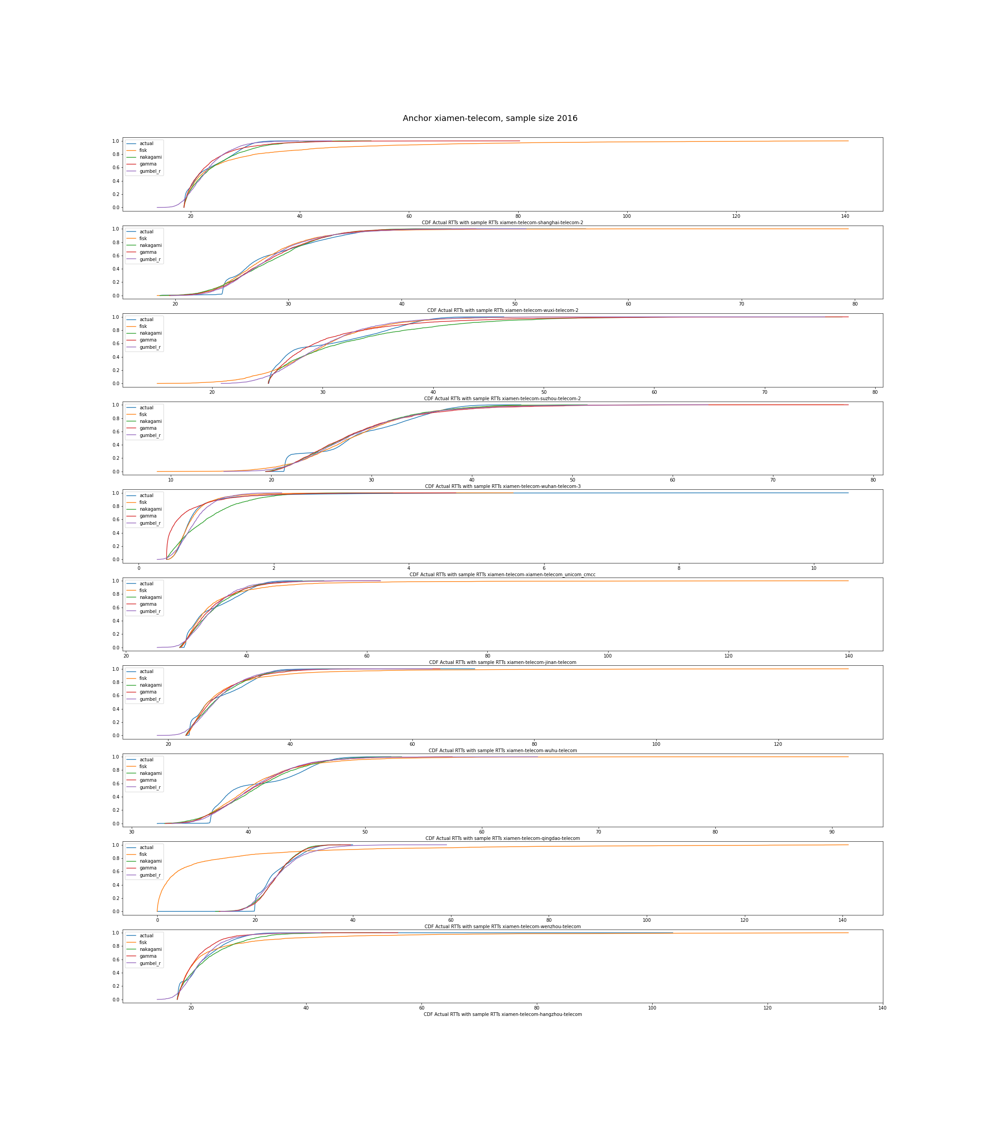
Xiamen
Findings:
1. Gumbel is ideal enough.

Slide 41
Simulation result
sim_latency {'fisk': 9.089194349494866, 'nakagami': 9.876907950512024, 'gamma': 9.469615556948993, 'gumbel_r': 9.50274030096147}
< 10
total latency violated {'deter': {}, 'deter_cons': {}, 'robust_fixed': {}, 'robust_variable': {}, 'dro': {}, 'socp': {}}

